Slide 1
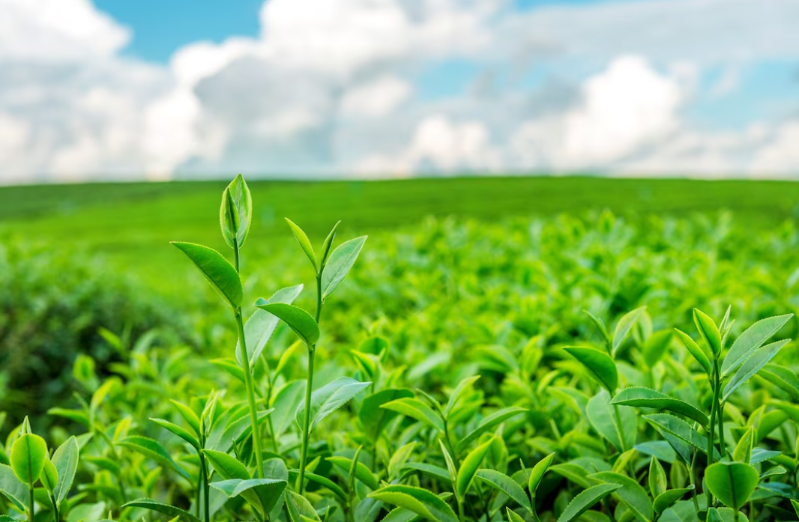

TEA LEAF DISEASE DETECTION USING ML/DL
Under the guidance of
Dr. JYOTISMITA TALUKDAR
Submitted by: SWEATA DAS (CSM21049)
NANDANA MEDHI (CSM21038)

Slide 2
TABLE OF CONTENTS
1. INTRODUCTION
2. LITERATURE REVIEW
3. METHODOLOGY
4. EXPERIMENTAL WORK
5. RESULTS AND DISCUSSIONS
6. CONCLUSION
7. FUTURE SCOPE

Slide 3
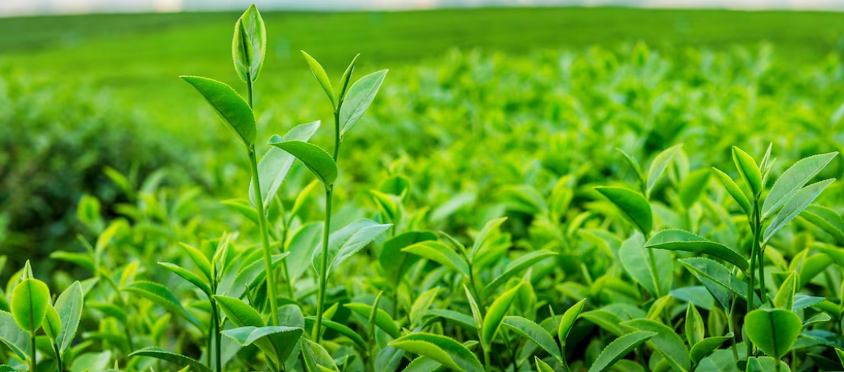
Introduction
Crop diseases have a significant economic impact which can affect plant function, growth, and overall agriculture activities. Since tea is widely used beverage and a perennial crop, illness that affect its production are common.
So the tea leaf illness must be inspected and an automating detection process through the use of machine learning not only can detect the disease
also can reduce the need for manual inspections, save time and increase the effectiveness of disease detection in the tea sector.

Slide 4
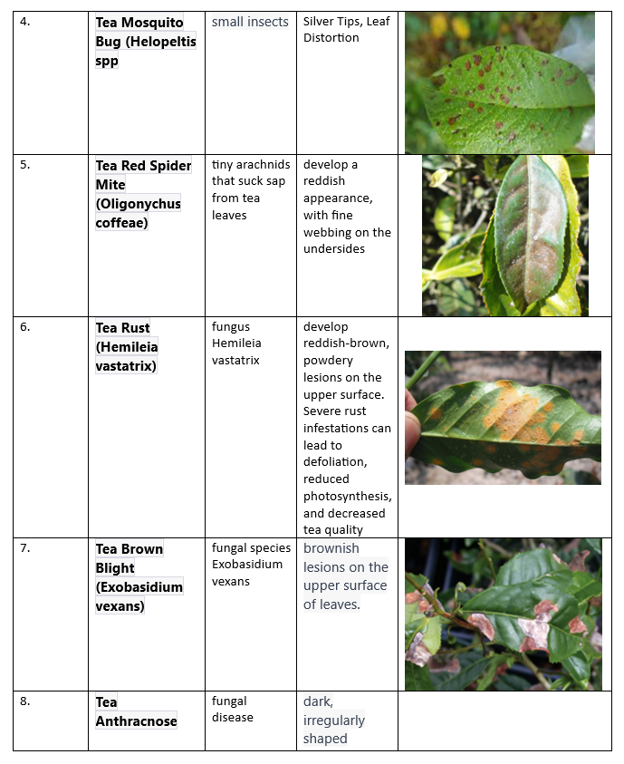
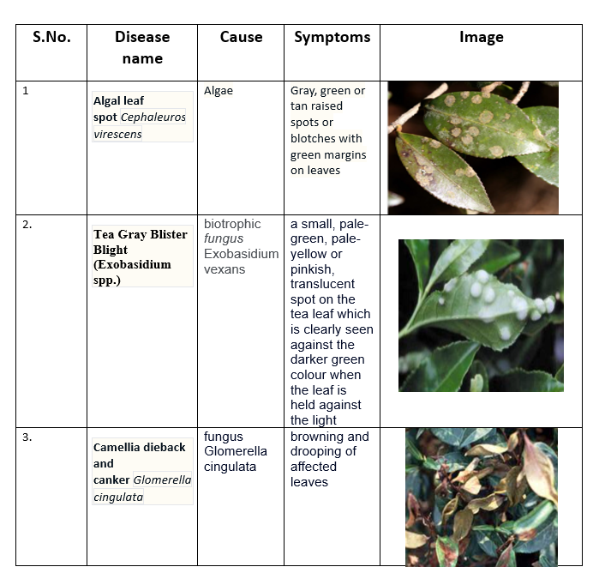
Tea Leaf Diseases
Most Common tea leaf diseases in Northeast India

Slide 5
Aim of the work
To develop an accurate and efficient system for automated identification of tea leaf diseases using machine learning techniques.
Investigate the transfer learning by pre-defined models such as ResNet, Sequential and VGG16 to increase disease detection capabilities and efficiency.

Slide 6
Machine Learning
Branch of artificial intelligence that enables computers to learn from data and make predictions or decision without being explicitly programmed.
Involves algorithm and statistical models to allow system to automatically learn and improve from experience
Convolutional Neural Network
Type of deep learning algorithm specifically designed for image analysis and pattern recognition.
Automatically learn and extract meaningful features from images.

Slide 7
Literature Review
 | Year | Author’s Name | Diseases | Algorithm Used | Performace
1 | 2020 | S.Mukhopadhyay M.Paul R.Pal D.De | Red Rust, Red Spider, Thrips, Helopeltis and Sunlight Scorching | Step 1: Image is identified by NSGA-II based clustering (Image Segmentation). Step 2:PCA(Principal Component Analysis) | Precision:77% Recall:84% F1-Score:78%
2 | 2020 | S. Bhowmik , A.K. Talukdar | Black Rot of Tea , Rust of Tea | CNN,SVM, GoogleNet,AlexNet | Accuracy: 96.3%
3 | 2023 | S.Dutta N.Gupta | Algal spot, Helopeltis, Gray Blight, Brown Blight, Red Spot | CNN | Precision:96.63% Recall:96.49% Accuracy:96.56%
4 | 2023 | A.Pandian S.N.Nisha K.kanchanadevi | Tea grey blight disease | CNN | Classification accuracy:98.99% Precision:98.51% Recall:98.48%
5 | 2023 | Minah Jung, Jong Seob Song | Bacterial spot, early blight, late blight | CNN | Accuracy:93%
6 | 2021 | Sumit Kumar, Veerendra Chaudhary, Ms. Supriya Khaitan Chandra | Leaf scorch, leaf mold, leaf scab | CNN | Training: 94% Validation: 88%
7 | 2021 | R.S.Latha G.R.Sreekanthh | Algal leaf spot, Gray blight, White spot, Brown blight, Red scab, Bud blight, and Grey blight. | CNN | Accuracy :94.45%

Slide 8
METHODOLOGY
Dataset used
Data Pre-processing
Model Selection
Train Model
Validate the Model
Test the Model
Evaluate the model

Slide 9
Dataset Used:
The “The tea Leaf Disease” dataset contains class of healthy tea leaves and unhealthy leaves. A total of 5867 images combined healthy and diseased leaves.
The Dataset contains 5 common diseases of tea along with healthy leaves:
Gray blight = 867 images
Brown blight = 1000 images
White spot = 1000 images
Algal leaf = 1000 images
Red leaf spot = 1000 images
It also contains 1000 images of healthy leaves.

Slide 10
Data Preprocessing
Rescaling:
Used 1./255.
Guarantees that pixel values are within appropriate range to train the models.
Data Loading and Splitting
Using flow_from_directory function
Set class mode: Categorical
Set the batch size
Splitting data into training and validation subset into 80:20

Slide 11
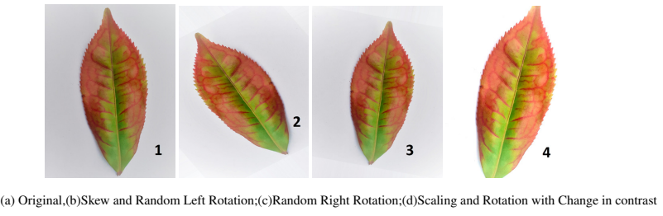
Data Augmentation:
Applied to generate additional images artificially to increase the sizeof the dataset
Techniques:
Rotation
Cropping
Flipping
Zooming

Slide 12
Model Selection
The models selected are
VGG16
ResNet and
Sequential
The models have shown to be highly effective in task involving picture categorization.

Slide 13
Train the Model
The process of teaching the model on a labeled dataset.
Divide the previously processed dataset into sets for testing, validation, and training.
We have taken 80% of the dataset for training.
Epoch size = 20 for each model.
Train the VGG16, ResNet, and Sequential models, then use the validation set to assess how well they performed.

Slide 14
Validate Model
After training, the model is evaluated on the validation set using the evaluate method. This is done to assess the model's performance on data it has not seen during training. The evaluation results, including validation loss and accuracy.

Slide 15
Testing the Model
Definition: Evaluating the model on an unseen dataset.
Importance: Assures generalization to new, unseen data.
Metrics: Accuracy, precision, recall, F1 score,

Slide 16
Evaluation Metrics
Evaluation is done based on various classification metrics:
Accuracy: Overall correctness.
Precision: Gives the accuracy of positive predictions made by the model.
Precision=TP/(TP+FP)
Recall: Measures the ability of a model to correctly identify all relevant instances.
Recall=TP/(TP+FN)
F1 Score: Indicate the models that has good precision and good recall.
F=2 X (Precision X Recall)/(Precision + Recall)

Slide 17
EXPERIMENT
WORKS

Slide 18
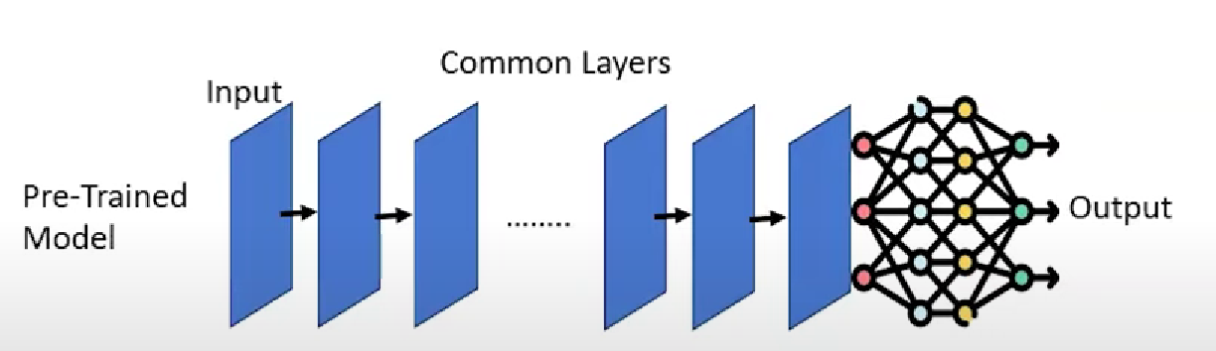
Transfer Learning
Transfer learning is a machine learning technique where a model trained on one task is adapted for a second related task.
Instead of training a model from scratch, knowledge gained from one task is transferred to another.

Slide 19
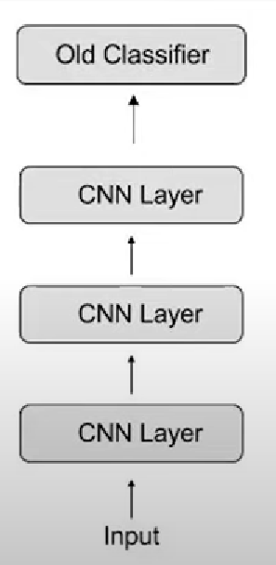
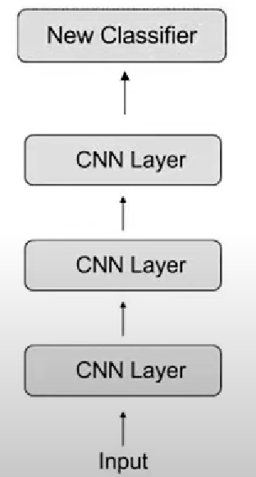
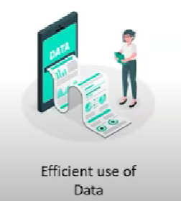
Why should we Use Transfer Learning?

Slide 20
V
G
G
1
6
Visual Geometry Group 16-layer, is a deep convolutional neural network architecture
Designed for image classification
VGG16 is known for its simplicity and uniform architecture
Consists of 16 weight layers
13 convolutional layers
3 fully connected layers.

Slide 21
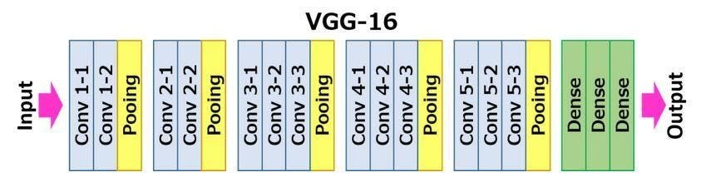
Visual Geometry Group 16-layer, is a deep convolutional neural network architecture
Designed for image classification
VGG16 is known for its simplicity and uniform architecture
Consists of 16 weight layers
13 convolutional layers
3 fully connected layers.
ARCHITECTURE
V
G
G
1
6

Slide 22
ARCHITECTURE
Visual Geometry Group 16-layer, is a deep convolutional neural network architecture
Designed for image classification
VGG16 is known for its simplicity and uniform architecture
Consists of 16 weight layers
13 convolutional layers
3 fully connected layers.
V
G
G
1
6
Input Layer:
Images of size 224x224 pixels
Three color channels (RGB).
Convolutional Blocks:
Five sets of convolutional blocks
Each followed by max-pooling layers.
Uses small 3x3 convolutional filters
Filter Size and Stride:
Filter size helps in capturing fine details
The stride helps in preserving spatial resolution.
Pooling Layers:
Max-pooling layers with a 2x2 window
A stride of 2 are applied
Reduces the spatial dimensions
Fully Connected Layers:
The final three layers are fully connected layers.
Representing the imagenet classes at that time.
Activation Function:
Used throughout the network after each convolutional and fully connected layer
Except for the output layer.
Softmax Output:
Uses the softmax activation function,
Which is suitable for multi-class classification problems

Slide 23
RESNET

Slide 24
RESNET
Short for residual networks
To address the challenges of training very deep networks
ResNet is particularly known for introducing the concept of residual learning, which helps in training very deep networks more effectively

Slide 25
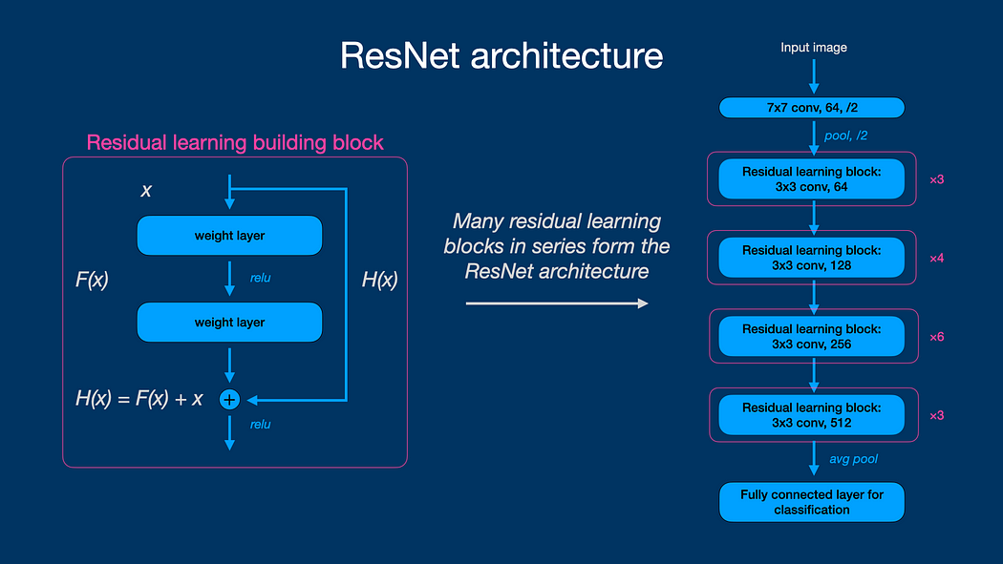
ARCHITECTURE
RESNET
Short for residual networks
To address the challenges of training very deep networks
ResNet is particularly known for introducing the concept of residual learning, which helps in training very deep networks more effectively

Slide 26
RESNET
Input:
Initial convolution and pooling:
Input image undergoes an initial convolution operation to extract basic features
2. Residual Blocks:
Core of the resnet architecture
Consists of two convolutional layers and a shortcut connection that adds the input to the output
Let x be the input to the residual block, and y be the output.
The output y is computed as follows:
y=F(x)+x
where F(x) is the residual mapping that the network needs to learn.
3.Bottleneck Architecture (Optional):
In deeper resnet models (e.G., Resnet-50 and higher)
A bottleneck architecture is often used
Involves three layers:
1x1 convolution (dimension reduction)
3x3 convolution, and another 1x1 convolution (dimension increase).
4.Stacking Blocks:
Multiple residual blocks are stacked together to form the overall network architecture.
5.Global Average Pooling (GAP):
Involves taking the average of each feature map across the spatial dimensions.
This results in a fixed-size feature vector regardless of the input size.
6.Output Layer:
A fully connected layer with a softmax activation function is typically used for classification tasks.
Short for residual networks
To address the challenges of training very deep networks
ResNet is particularly known for introducing the concept of residual learning, which helps in training very deep networks more effectively
ARCHITECTURE

Slide 27
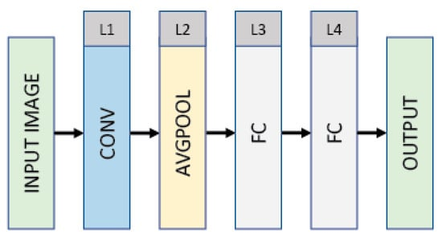
Input:
Initial convolution and pooling:
Input image undergoes an initial convolution operation to extract basic features
2. Residual Blocks:
Core of the resnet architecture
Consists of two convolutional layers and a shortcut connection that adds the input to the output
Let x be the input to the residual block, and y be the output.
The output y is computed as follows:
y=F(x)+x
where F(x) is the residual mapping that the network needs to learn.
3.Bottleneck Architecture (Optional):
In deeper resnet models (e.G., Resnet-50 and higher)
A bottleneck architecture is often used
Involves three layers:
1x1 convolution (dimension reduction)
3x3 convolution, and another 1x1 convolution (dimension increase).
4.Stacking Blocks:
Multiple residual blocks are stacked together to form the overall network architecture.
5.Global Average Pooling (GAP):
Involves taking the average of each feature map across the spatial dimensions.
This results in a fixed-size feature vector regardless of the input size.
6.Output Layer:
A fully connected layer with a softmax activation function is typically used for classification tasks.
SEQUENTIAL

Slide 28
Input:
Initial convolution and pooling:
Input image undergoes an initial convolution operation to extract basic features
2. Residual Blocks:
Core of the resnet architecture
Consists of two convolutional layers and a shortcut connection that adds the input to the output
Let x be the input to the residual block, and y be the output.
The output y is computed as follows:
y=F(x)+x
where F(x) is the residual mapping that the network needs to learn.
3.Bottleneck Architecture (Optional):
In deeper resnet models (e.G., Resnet-50 and higher)
A bottleneck architecture is often used
Involves three layers:
1x1 convolution (dimension reduction)
3x3 convolution, and another 1x1 convolution (dimension increase).
4.Stacking Blocks:
Multiple residual blocks are stacked together to form the overall network architecture.
5.Global Average Pooling (GAP):
Involves taking the average of each feature map across the spatial dimensions.
This results in a fixed-size feature vector regardless of the input size.
6.Output Layer:
A fully connected layer with a softmax activation function is typically used for classification tasks.
usually refers to a linear stack of layers in which you can add one layer at a time.
model architecture provided by the Keras library, which is now integrated into TensorFlow
.
SEQUENTIAL

Slide 29
SEQUENTIAL
Build/Define a network model using predefined layers in Keras.
Compile the model with model.compile()
Train the model with model.fit()

Slide 30
RESULTS
AND DISCUSSIONS

Slide 31
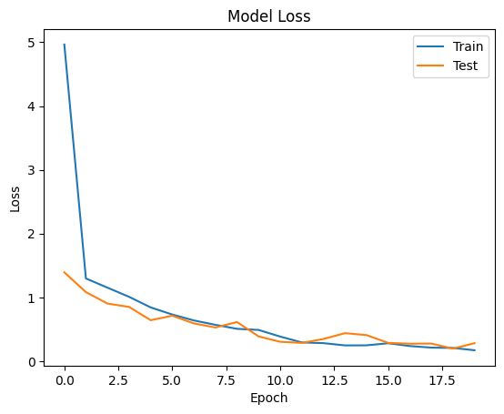
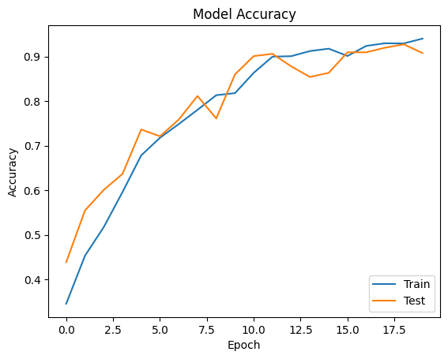
Result and Discussion
Training and Validation Customized CNN

Slide 32
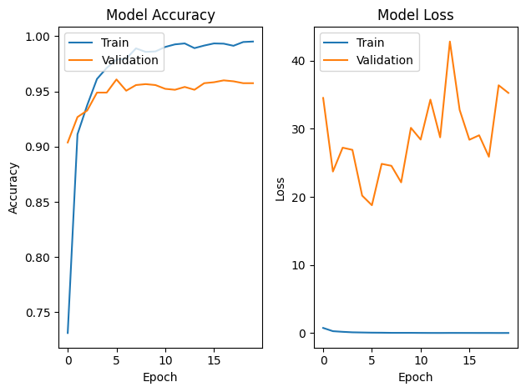
Training and Validation of Customized VGG16 Model

Slide 33
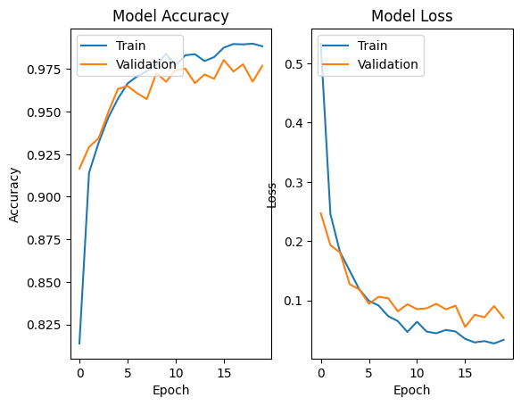
Training and Validation of Customized ResNet Model

Slide 34
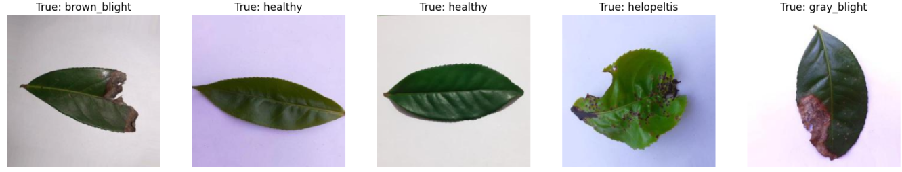
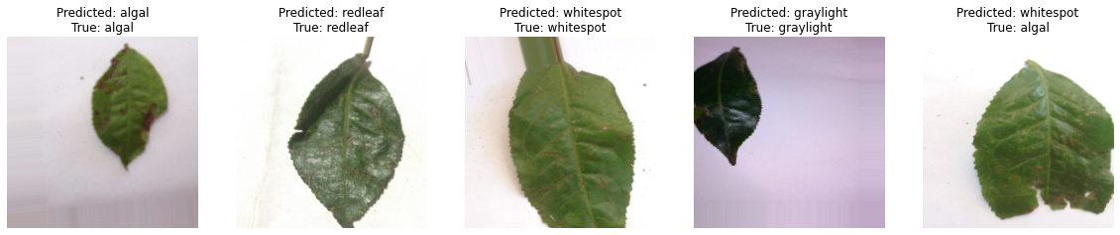
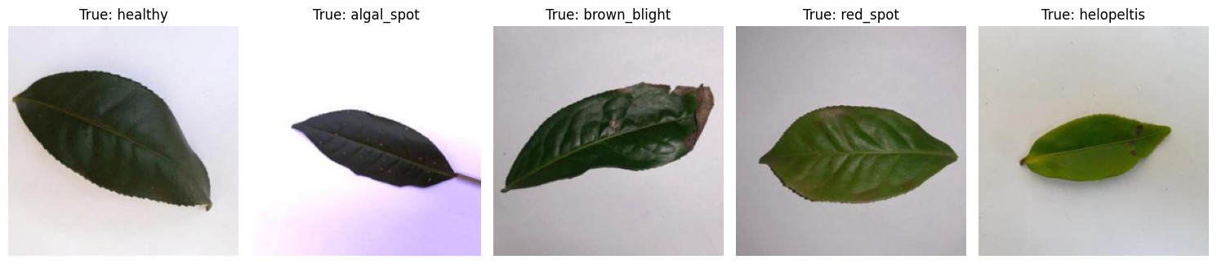
True Label on Dataset

Slide 35
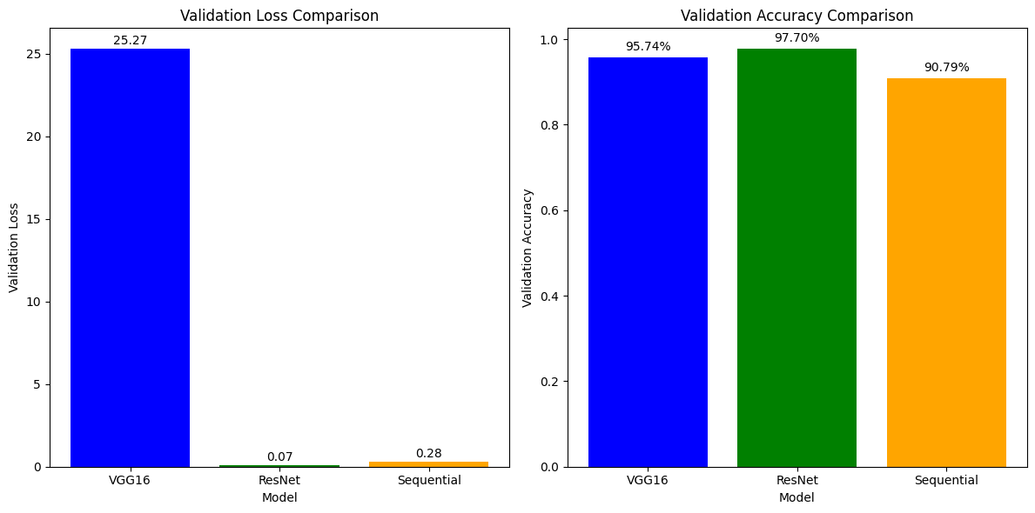
Model Comparison Result

Slide 36
Overall Conclusion
ResNet emerges as the most promising model, boasting the lowest validation loss (0.07 %) and the highest accuracy (97.70%). VGG16, with its higher validation loss, faces challenges in generalization, while the Sequential model, while decent, falls short compared to ResNet

Slide 37
Future Scope
To identify other tea leaf illnesses, the suggested model might be improved even further.
The approach may be implemented in real-world applications and coupled with Internet of Things devices.
Moreover, the model may be expanded to include additional crop diseases.

Slide 38
THANK YOU

